Slide 1
Think – Pair – Share
Read these two quotes:
“I've been called a boss. All there is to it is having friends, doing things for people, and then later on they'll do things for you...”
"Stop them damned pictures. I don't care so much what the papers say about me. My constituents can't read. But, damn it, they can see pictures!”
Turn to your neighbor and discuss these questions:
What do these quotes mean? What is a common theme between the two?

Slide 2
What Is a Political Cartoon?

Slide 3
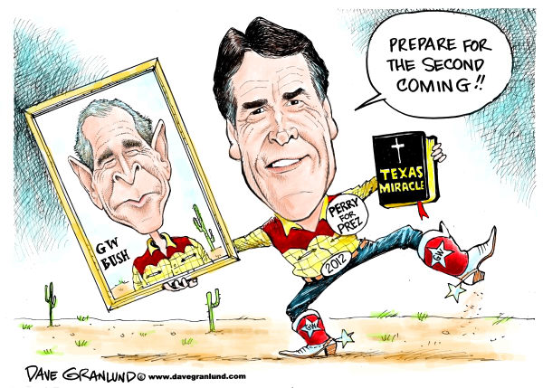
Two Types of Political Cartoons
CARICATURE
usually exaggerated or funny subject/individual
ALLUSION
the situation or context into which the individual is placed

Slide 4
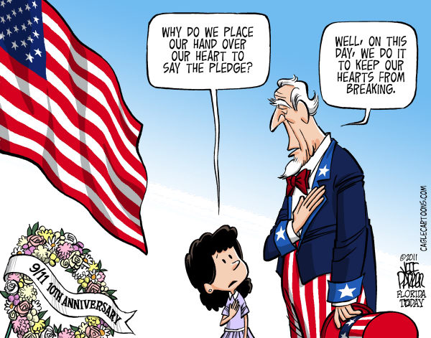
Why Are Political Cartoons Important?
They inform, persuade, or advocate
Personal opinions
Comment about current events
Encourage people to think

Slide 5
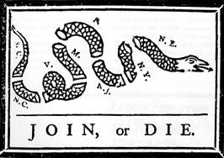
First Political Cartoon

Slide 6
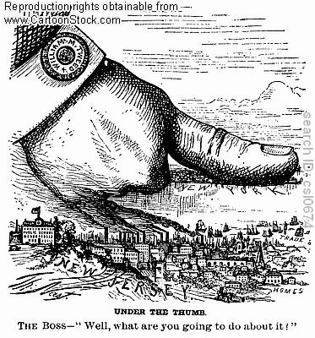

Slide 7
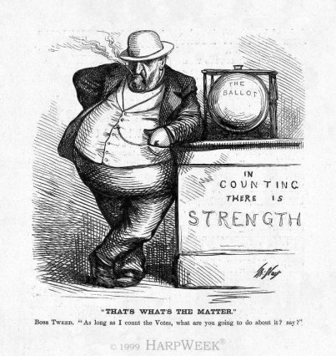

Slide 8
