Slide 1
The West: Railroads

Slide 2
To study the history of the American West, you will need a to deal with multiple points of view:
Conflict: Settlers and Native Americans
Conflicts among and factions within tribes
Conflict: Miners and farmers
Conflict: Ranchers and Free Grazers
Conflict: (the image of self reliance and rugged individualism vs. resentment of the federal government for not helping enough)

Slide 3
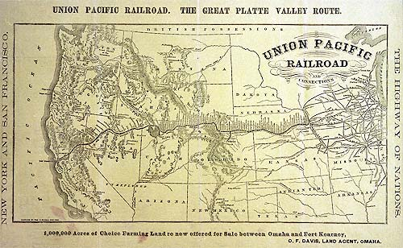

Slide 4
How do you build a transcontinental railroad?

Slide 5
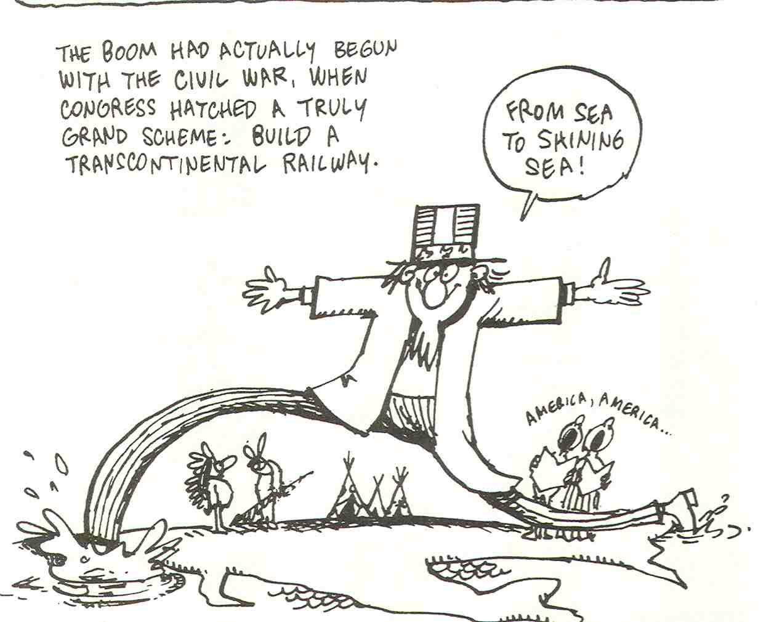

Slide 6
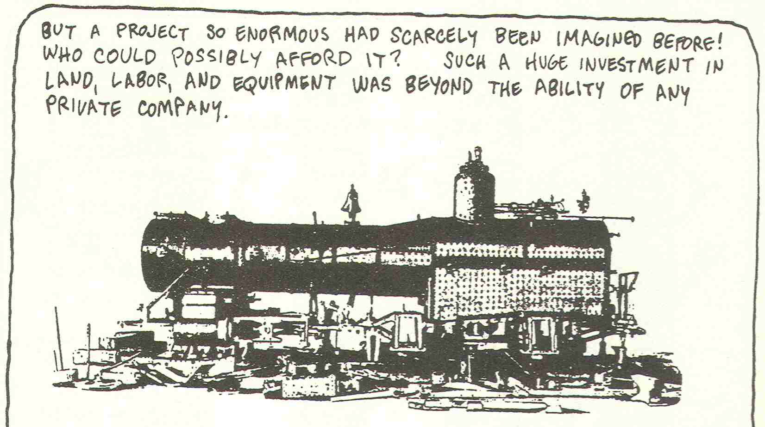

Slide 7
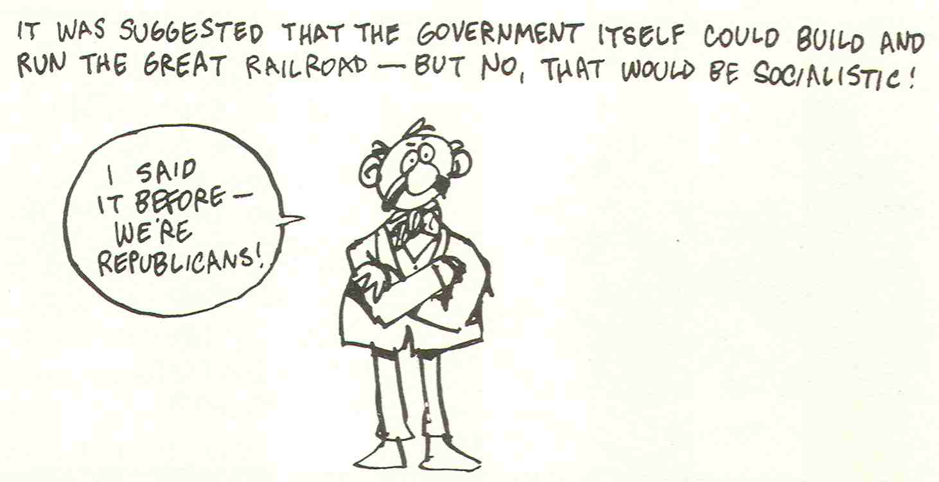

Slide 8
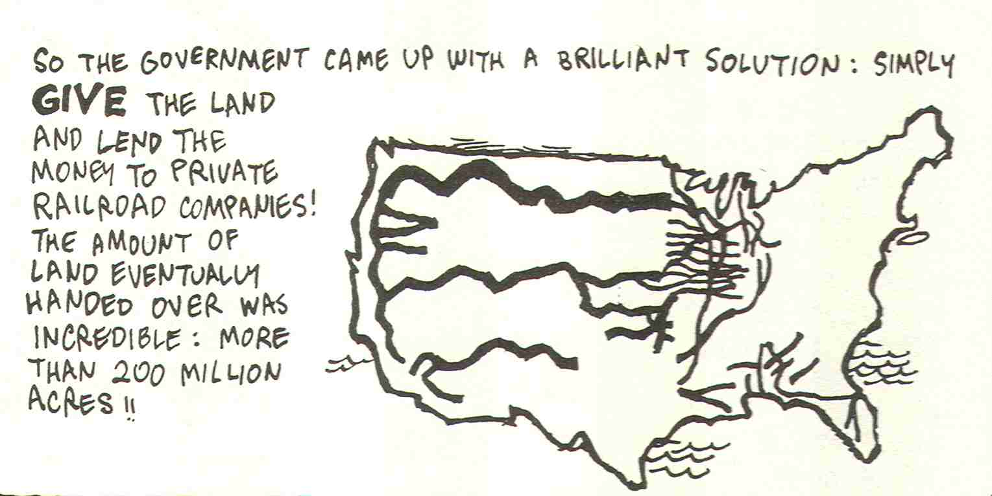

Slide 9
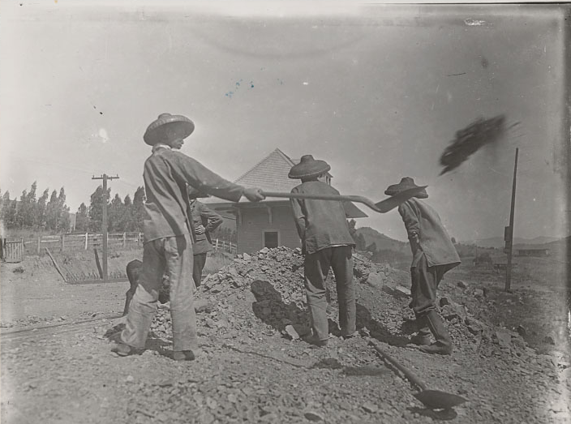
Who built the Pacific Railroad?
Civil War veterans
Freed slaves
Indians
Mormons
Immigrants
Irish
Chinese-led by Charles Crocker

Slide 10
Change Brought by Railroads
Drove industrialization during the 19th century
Provided a modern transportation network, increased demand for iron and steel, served as model for big business
Led to large scale farming and economic development in the west

Slide 11
Change Brought By Railroads Cont.
Reduced the journey from the east to the west and the variety and availability of consumer goods
Land grants given by the government promoted further growth in the territories along the route
Created markets along the railroad routes leading to a relationship between resources and industry
Forced American Indians on to reservations

